Slide 1
PLANNING BY- CHINTAN PRAJAPATI

Slide 2
Why Goals are important for an organization
Goals provide a sense of direction
Goals focus our efforts
Goals guide our plans and decision
Goals help us to evaluate our progress

Slide 3
PLANNING
Planning is the process of settings goals and choosing the means to achieve those goals.
Selecting missions and objectives as well as the actions to achieve them, which requires decision making that is, choosing a course of action amongst all alternatives

Slide 4
Close Relationship between planning and controlling
New Plans
No undesirable deviation from plans
Implementation of Plans
Controlling comparing plans with results
Planning
Undesirable deviation
Corrective
action

Slide 5
Types Of Plans
Mission or purposes
Mission or purposes identifies the basic purposes or function or tasks of an enterprise or agency or any part of it.
Goals or Objectives
Objectives or goals are the ends toward which activity is aimed.
They represent not only the end point of planning but also the end toward which organizing, staffing, leading and controlling are aimed.

Slide 6
Types of Plan
Hierarchy of organization plans: Organizations are managed according to two plans.
1) Strategic plans: Plans designed to meet an organization’s broad goals.
2) Operational plans: Plans that contain details for carrying out, or implementing, those strategic plans in day to day activity

Slide 7
OPERATIONALIZING STRATEGY
GOALS
STRATEGIC PLANS
SINGLE-USE PLANS
STANDING PLANS
POLICIES
PROGRAMS
BUDGET
STANDARD PROCEDURE
AND METHODS
PROJECTS
RULES

Slide 8
Types of Plan
Single use plans: A detailed course of action used once or only occasionally to solve a problem that does not occur repeatedly.
Program: It is a single use plan that covers a relatively large set of activities.
Programs includes:
The major steps required to reach an objective.
The organization unit or member responsible for each step.
The order and timing of each step.

Slide 9
Types of Plan
Projects:
The smaller and separate portion of the program.
Budget:
A statement of expected results expressed in numerical terms. Formal quantitative statements of the resource allocated to specific programs or projects for given period.

Slide 10
Types of Plan
Standing Plans:
An established set of decisions used by managers to deal with recurring or organizational activities, major types are policies, procedures, and rules.
Policy:
A standing plan that establishes general guidelines for decision making.
Rules:
Standing plans that detail specific actions to be taken in a given situation.

Slide 11
Types of Plan
Procedure:
A standing plan that contains detailed guidelines for handling organizational actions that occur regularly.

Slide 12
STEPS INVOLVED IN PLANNING
Being aware of opportunities
In light of :
The market
Competition
What customers want
Our strengths
Our weakness
2. Establishing Objectives/ Setting Objectives or Goals
where we want to be and
what we want to accomplish and when
Developing Premises
In what environment – internal or external will our plans operate?
Determining Alternatives
What are the most promising alternatives in accomplishing our Objectives

Slide 13
STEPS INVOLVED IN PLANNING
Evaluating alternative courses
Which alternatives will give us the best chance of meeting our goals at the lowest cost and highest profit?
Selecting a course
Selecting the course of action we will pursue
Formulating derivative plans (Supporting plan)
Such as plans to:
Buy equipment
Buy Materials
Hire and train workers
Develop new product

Slide 14
STEPS INVOLVED IN PLANNING
Quantifying plans by budgeting
Develop such budgets as:
Volume and price of sales
Operating expenses necessary for plans
Expenditures for capital Equipment
Co-ordination of Short and long-range plans

Slide 15
Making Planning Effective
Linked to Long term objectives
Consistency
Everyone participates
Feasible
Flexible
Simple
Top Management Support

Slide 16
What Is an Objective?
“Objective are goals, aims or purposes that organization wish over varying periods of time”

Slide 17
OBJECTIVES
An objective is verifiable when at the end of the period one can determine whether or not it has been achieved.
The Nature of Objectives
Objectives state end results and overall objectives need to be supported by sub objectives. Thus, objectives form a hierarchy as well as network.

Slide 18
HOW TO SET CORPORATE OBJECTIVES
Socio-economic purpose Mission statement
Overall objectives of org. Corporate objectives
Departmental objectives
Individuals and team targets
To become the leading supplier of computers in London
To increase sales in London by 10% in the next 5 years
Top down approach
Bottom-up approach
e.g. (marketing department) to achieve a 10% share of the computer market in London within the next 5 years
e.g. to design questionnaires as part of market research

Slide 19
Management By Objectives (MBO)
A method whereby managers and employees define objectives for every department, project, and person and use them to monitor subsequent performance.

Slide 20
OBJECTIVE SETTING
In an MBO, good goals are SMART goals:
S Specific
M Measurable
A Achievable
R Result oriented
T Time-related
S
U
C
C
E
S
S
WORK
HAVE

Slide 21
THE NATURE & PURPOSE OF MBO
MBO is concerned with goal setting and planning for individual managers and their units.
The essence of MBO is a process of joint goal setting between a supervisor and a subordinate.
Managers work with their subordinates to establish performance goals that are consistent with higher organizational objectives.
MBO helps clarify the hierarchy of objectives as a series of well-defined means-ends chains.

Slide 22
STEPS FOR MBO
STEP 1: SET GOALS
STEP 2: DEVELOP PLANS
Corporate Strategic goals
Departmental goals
Individual goals
Action plan
Course of action
For both workgroups and individuals
Review Progress & Take Corrective Action
Appraise Performance
How are we doing?
Do we need to restate our goals?
STEP 3: REVIEW PROGRESS
STEP 4: APPRAISE OVERALL PERFORMANCE
Notes:
Set goals – not day to day but rather goals that answer at least a portion of the “where are we going” question and then are linked with other goals
Plans – Steps required
Review – make sure plan is working; Is corrective action necessary either in the plan or the execution?
CAUTION: Don’t get locked into PREDETERMINED behavior or sacrifice QUALITY to “MEET” goal

Slide 23
MAKING MBO PROCESS EFFECTIVE
If MBO is to be successful, it must start at the top of the organization
Employees must be educated about what MBO is and what their role in it will be.
Managers must implement MBO in a way that is consistent with overall organizational goals.

Slide 24
Managers tell their subordinates what organizational and unit goals and plans top management has established.
Managers meet with their subordinates on a one-to-one basis to arrive at a set of goals for each subordinate that both develop and to which both are committed.

Slide 25
Goals must be written and very clearly stated.
Managers must play the role of counselors in the goal-setting and planning meeting.
The employee is rewarded on goal attainment.

Slide 26
Strategies, Policies and Planning Premises
Strategy
Strategy refers to the determination of the mission and the basic long term objectives of an enterprise, followed by the adoption of courses of action and allocation of resources necessary to achieve these aims.
Strategy
Objective is the part of strategy formulation.
Policy
policy is the means of achieving the objective.

Slide 27
EXAMPLES

Slide 28

Strategy used by colors channel

Slide 29
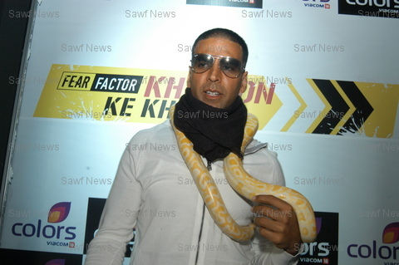
Launching a high profile program on day 1 opening with ‘khatron ke khiladi’

Slide 30


Reality show Fiction shows

Slide 31

Mythology

Slide 32

Strategies used in telecom industry
TATA DOCOMO
“A 1 second pulse instead of the usual 1 minute pulse offered by other mobile service providers”.

Slide 33
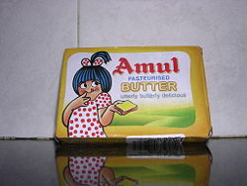
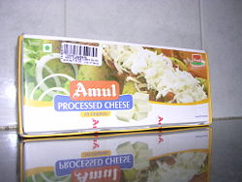

Strategies used by “AMUL”
World's Largest Pouched Milk Brand
World's Biggest Vegetarian Cheese Brand
Notes:
33

Slide 34
Wide range of product categories caters consumers across all market segments. For example, Amul Kool is targeted at children, while teenagers prefer Kool Café.
High profile locations: Amul parlors are today present on campuses of Infosys, Wipro, IIM-A, IIT-B, Temples, Metro rail, Gardens and railway stations in Gujarat.
Amul’s approach is to promote its brands in a rotational cycle of 2 to 3 years.
Ice-cream 1996,
category re-visited in 1999, in order to improve availability of the product and make it affordable.
Cheese in 2001,
Amul Masti Chaas in 2004-05,
Nutramul and Kool Kafe in 2006
Amul Koko — cold chocolate drink in 2009

Slide 35
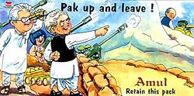
Notes:
35

Slide 36
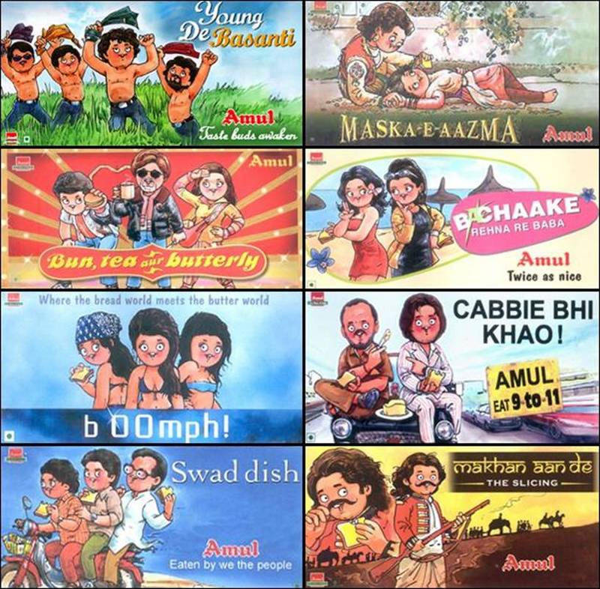
Notes:
36

Slide 37
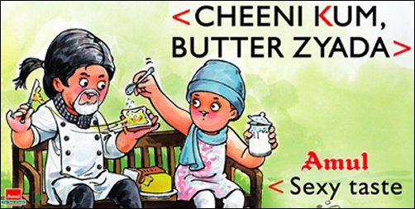
Notes:
37

Slide 38

Notes:
38

Slide 39

Notes:
39

Slide 40
THE STRATEGIC
PLANNING PROCESS

Slide 41
(2)
Analyze
the
environment
(3)
Identify
the
Opportunites
and threats
(1)
Identify
the
Org.’s
current
mission
and
strategies
(6)
Formulate
strategies
(7)
Implement
strategies
(8)
Evaluate
result
SWOT
Analysis
(4)
Analyze
the
Org.’s
` resources
(5)
Identify
strengths
and
weaknesses

Slide 42
STEP-1 INPUT TO THE ORGANISATION

Slide 43
Skills and abilities of employee
Available resources
Financial position
Quality of it’s product and services
Example
Every day Amul collects 7 million litres of milk from 2.6 million farmers (many illiterate), converts the milk into branded, packaged products, and delivers goods to over 80,00,000 retail outlets across the country

Slide 44
STEP 2 ENTERPRISE PROFILE IDENTIFYING THE ORGANISATION’S CURRENT VISION, MISSION, OBJECTIVES AND STRATEGIC INTENT

Slide 45
Strategic Planning
First Stage of Strategic Planning may involve:
Futures Thinking
Thinking about what the business might need to do 10–20 years ahead
Strategic Intents
The commitment to win in the competitive environment.

Slide 46
Vision and Mission
A vision statement tells people
Where we want to go
What we want to become
What we want to accomplish
Why it is important
And a mission expresses the organization’s:
Purpose
Business
Values

Slide 47
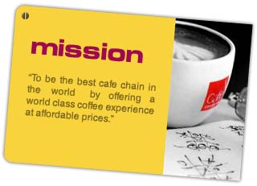

Slide 48
Componentes of mission statement
(1)Customers
(2)Products or services
(3)Markets

Slide 49
(1) Customers
Who are the organization’s customer?
For Amul : Teenagers
Children
For Parle-G : All age group people

Slide 50
(2) Products or services
AMUL’S main products are
- Amul Milk - Amul Pizza
- Amul Butter
- Amul Cheese - Amul Shrikhand
-Amul ice cream - Amul Curd
- Amul chaas
-Amul koko

Slide 51
(3)Markets
Where does organization compete geographically?
E.G.---Amul emphasis is on whole india.

Slide 52
STEP 3 ANALYZING THE ENVIRONMENT Assumptions about the environment in which the plan is to be carried out.

Slide 53
STEP 4 Identifying strengths and weaknesses

Slide 54
Strengths
Any activity the organization does well or any unique resources that it has.
Weaknesses
Activity the organization does not well or any resources that needs but does not posses.

Slide 55
STEP 5 IDENTIFYING OPPORTUNITIES AND THREATS

Slide 56
`.
OPPORTUNITIES:-positive trends in external environmental factors
THREATS:- Negative trends in external environmental factors

Slide 57
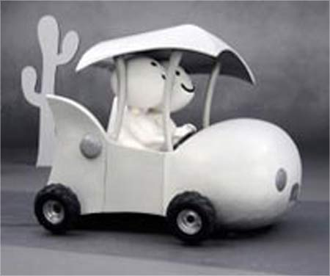

STEP 6
FORMULATING STRATEGIES
Established at corporate, business and functional level
Strategy formulation for competitive advantage
Diversify, International Expansion, Joint Ventures, liquidation

Slide 58

STEP 7
IMPLEMENTING STRATEGIES
Top managers should act as leaders
For better implementation managers should seek advise
Motivation to the workforce

Slide 59


STEP 8
EVALUATING THE RESULTS
Assessing the results of the current strategy with the previous ones
Adjustments should be made if necessary.

Slide 60
Tows Matrix A Modern Tool For Analysis Of The Situation
Tows matrix has been introduced for analyzing the competitive situation of the company or even of a nation that leads to the development of four distinct sets of strategic alternatives.
The Tows matrix is a conceptual framework for a systematic analysis that facilitates matching of the external threats and opportunities with the internal weaknesses and strengths of the organization.

Slide 61
Four Alternative Strategies
The strategies are based on the analysis of the external environment (threat and opportunities) and the internal environment (weaknesses and strength).
1. WT strategy
2. WO strategy
3. ST strategy
4. SO strategy

Slide 62
SWOT analysis of strengths, weaknesses, opportunities,and threats.

Slide 63
TOWS Matrix

Slide 64

Blue Ocean Strategy
In pursuit of Opportunities in uncontested markets
Go where the profits and growth are - and where the competition isn’t

Slide 65
Blue Ocean Strategy
The blue ocean strategy focuses on uncontested market by offering a product or service that is unique in a market space where there is no competitor thus making competition irrelevant.
Red Ocean Strategy
The red ocean strategy aimed at “bloody” current competition in which companies try to be little better than their competitors

Slide 66
Red Océan Versus Blue Océan Strategy
Red Ocean Strategy
Blue Ocean Strategy
Compete in existing market space
Create uncontested market space
Beat the competition
Make the competition irrelevant
Differentiation or low cost
Differentiation and low cost
Competitive Advantage
Value Innovation
Segment existing customers
Attract noncustomers
Exploit existing demand
Create and capture new demand
© Kim & Mauborgne 2006

Slide 67
Blue Ocean Strategy
For companies aiming Blue Ocean Strategy, four actions should be considered.
First, identify and eliminate those factors that may be unimportant to the buyer.
Second, if elimination is not an option, consider those factors.
Third, raise or strengthen those factors that are unique.
Fourth, create new or new and unique factors that are wanted by the buyers but are ignored by the competitors.

Slide 68
Boston Consulting Group (BCG) Matrix
Business portfolio matrix that uses market growth rate and relative market share as the indicators of the firm’s strategic position.
Market growth rate
A measure of the annual growth percentage of the market in which the business operates.
Relative market share
The firm’s market share divided by the market share of its largest competitor.

Slide 69
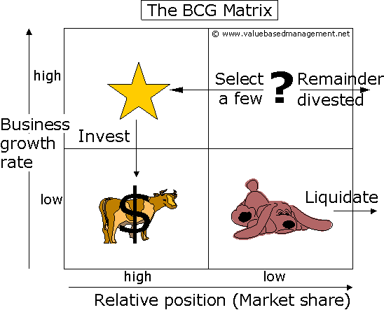

Slide 70
Four segments of the BCG Matrix
Placing products in the BCG matrix provides 4 categories in a portfolio of a company.
Question Mark
Stars
Cash cow
Dog

Slide 71
Question Marks (high growth, low market share)
Question Marks have the worst cash characteristics of all, because they have high cash demands and generate low returns, because of their low market share.

Slide 72
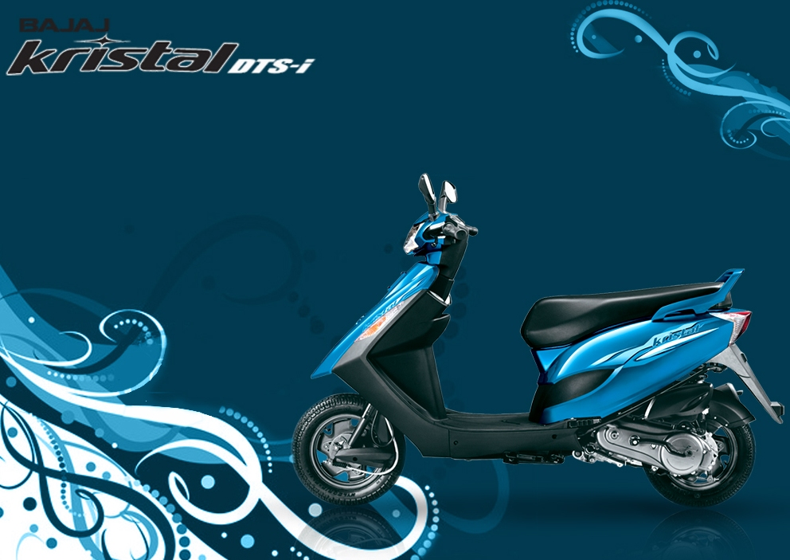
Question Mark

Slide 73
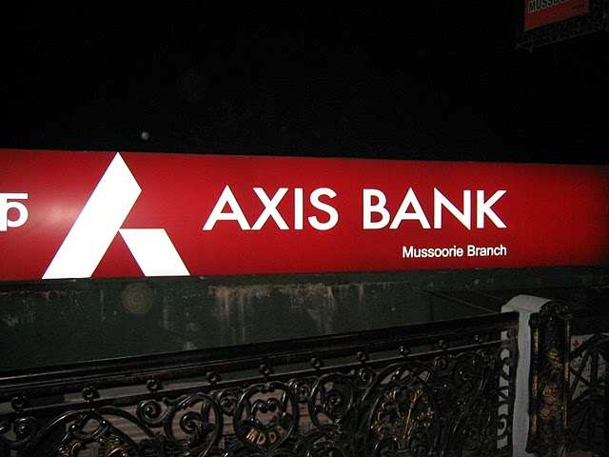
Stars (high growth, high market share)
Stars are using large amounts of cash. Stars are leaders in the business. Therefore they should also generate large amounts of cash.
Offer attractive profit and growth opportunities.

Slide 74
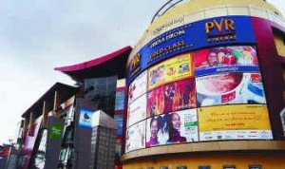
Cash Cows (low growth, high market share)
Profits and cash generation should be high. Because of the low growth, investments which are needed should be low.
Generally yesterday’s stars that have matured.

Slide 75
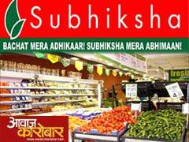
Dogs (low growth, low market share)
Avoid and minimize the number of Dogs in a company.
Dogs must deliver cash, otherwise they must be liquidated.
Typically generate low profits, and in some cases may even lose money.

Slide 76
Level of companies strategies

Slide 77
Hierarchy of Companies Strategies/ Three Level of Strategy
In large, diversified companies, the overall strategies may take form of a hierarchy.
In general, most organizations engage in both strategic planning and operational planning.
At the top of the pyramid is the corporate-level strategy.
The second level in the hierarchy is business strategies.
On the third hierarchy level, functional strategies are developed.

Slide 78
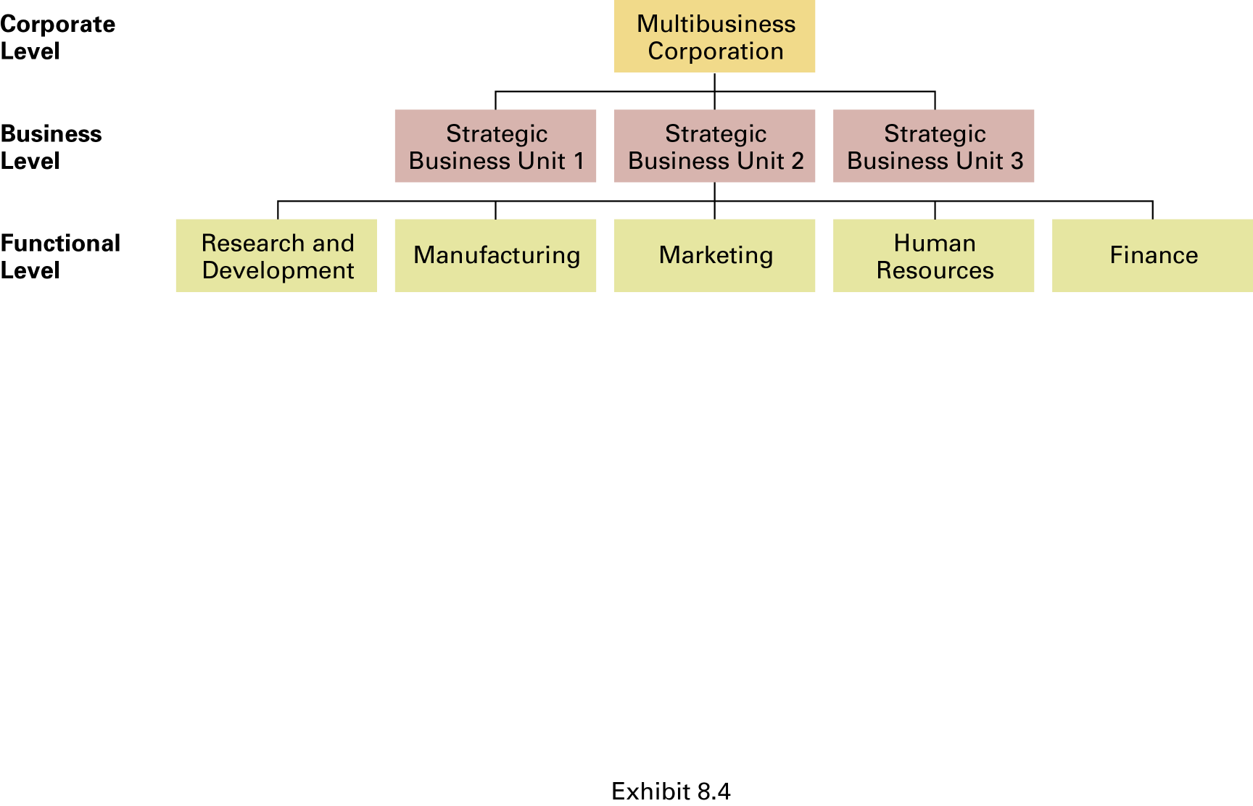
Levels of Organizational Strategy

Slide 79
Corporate Level Strategy
Top management’s overall plan for the entire organization and its strategic business units
Diversification/Growth
An organization adding new products, services, or businesses.
Unrelated diversification
Adding products, services, or businesses that are different from the ones an organization currently has.
Related diversification
Adding products, services, or businesses that have some relationship to the ones an organization currently has or share a core competency.

Slide 80
Business Level Strategy
It is useful for multi-product and multi related enterprise
Each SBU will have different Mission, Vision, Objectives etc
Each SBU will have its own set of competitors
and own set of strategy
SBU may be of
-Functional based
-Product based
Each SBU will have CEO who has responsibility for
strategic planning and profit performance.

Slide 81
Functional level strategy
Strategy formulated by a specific area in an effort to carry out business unit strategy.
Functional strategy specifies activities necessary to implement the organization's corporate and business strategies.
Operations
Research and Development (R&D)
Financial
Human resource management
Marketing

Slide 82
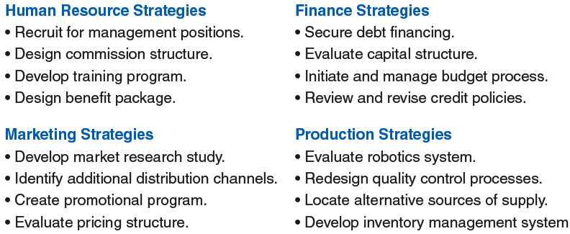
Examples of Functional Strategies

Slide 83
Porter’s Industry Analysis and Generic competitive Strategies

Slide 84
Porter’s 5 Forces
The Five Forces model of Porter is an outside-in business unit strategy tool that is used to make an analysis of the attractiveness (value...) of an industry structure

Slide 85
Porter’s 5 Forces Model
Allows the development of a competitive strategy
Suggests 5 main forces may be decisive in helping shape the outcome:
Suppliers
New Entrants
Substitutes
Buyers
Industrial competitors

Slide 86
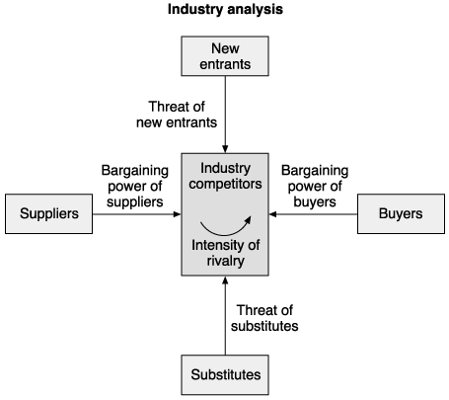

Slide 87
Threat to new Entrant …
… large capital requirements or the need to gain economies of scale quickly.
… strong customer loyalty or strong brand preferences.
… lack of adequate distribution channels or access to raw materials.

Slide 88
Power of Suppliers …
… high when
* A small number of dominant, highly concentrated suppliers exists.
* Few good substitute raw materials or suppliers are available.
* The cost of switching raw materials or suppliers is high.

Slide 89
Power of Buyers …
… high when
* Customers are concentrated, large or buy in volume .
* The products being purchased are standard or undifferentiated making it easy to switch to other suppliers.
* Customers’ purchases represent a major portion of the sellers’ total revenue.

Slide 90
Substitute products …
… competitive strength high when
* The relative price of substitute products declines .
* Consumers’ switching costs decline.
* Competitors plan to increase market penetration or production capacity.

Slide 91
Rivalry among competitors
… intensity increases as
* The number of competitors increases or they become equal in size.
* Demand for the industry’s products declines or industry growth slows.
* Fixed costs or barriers to leaving the industry are high.

Slide 92
Coca Cola
Traditional competition:
Prices of Pepsi, local brands
Market share
Promotional actions of competitors
New entrants:
New “look-a-like” manufacturers
Substitute products:
Fashionable new drinks, milk drinks, coffee, beer, water………

Slide 93
Coca-cola
Suppliers:
Price and availability of ingredients on world market
Quality, speed, safety, traceability, flexibility of supply chain
Buyers/consumers:
High as a result of intense competition both among branded and unbranded products.
Combined purchase power of shops, bars, supermarkets

Slide 94
Porter’s Generic Competitive Strategies

Slide 95
Cost Leadership
Cost leader chooses a low to moderate level of product differentiation relative to its competitors.
Differentiation Strategy
The objective of the differentiation strategy is to achieve a competitive advantage by creating a product that consumers perceive as different or distinct in some important way.
Product differentiation can be achieved in three ways
Quality
Innovation
Responsiveness to customers

Slide 96
Focused Strategies
Focus Strategies position a company to compete for customers in a particular market segment, which can be defined geographically, by type of customers, or by region or even by locality.
Focused Cost Leadership Strategy :
If a company uses a focused low – cost approach, it competes against the cost leader in the market segment in which it has no cost disadvantage.
Focused Differentiation Strategy :
If a company uses a focused differentiation approach, then all the means of differentiation that are open to the differentiator are available to the focused company.

Slide 97
Premising and Forecasting
Planning premises are defined as the anticipated environment in which plans are expected to operated.
They include assumptions or forecasts of the future and known conditions that will affect the operation of plans.

Slide 98
Premising and Forecasting DEFINIATION:
Planning premises means systemic & logical estimate for the future effecting planning.
“Planning premise are the assumption providing a ground against which the estimated events affecting the planning will take place”.

Slide 99
TYPES OF PLANNING PREMISE
Premises at the view point of place.
External premises
Internal premises
Premises at the view point of calculation.
Controllable premises
Uncontrollable premises
Premises at the view point of control.
Tangible premises
Intangible premises

Slide 100
Number of factor affecting planning considering the place of the factors. Some factors are internal and some are external
THE EXTERNAL factor are:
Economic
Political-legal
technological
Socio-cultural
competitive

Slide 101

Economical factor: Infrastructure Raw material
Political factor:
Law relating to business
Political interference in business
Competitive factor:
Strength & weakness of competitor
Price change by competitor
Product feature of competitor
Social cultural factor:
Acceptance of new products
Change in lifestyle of people

Slide 102
The internal factor are:
Organization structure
Management System
Research and Development
Production
Operations
Procurement
Marketing
Products
Human Resources
Financial Resources
Organization Image
Organization Climate and Change
Relations with the customer

Slide 103

Controllable premises are:-
Controllable premises are those that can be controlled by an organization’s actions. This are mostly internal like: organizational policies, structure, system, process.
Uncontrollable premises are:-
Its those which dose not controlled by organization. And those are mostly external factor like: Economic growth, Innovation by competitor, taxation policy of government.

Slide 104
TANGIBLE PREMISES:
Tangible premises are those which can be expressed in Quantitative terms like monetary unit, unit of product, labour hour, machine hour.
e.g:-- sales forecasting.
INTANGIBLE PREMISES:
The intangible premises are Qualitative in nature and can not translate into quantity.
e.g:--- image of the company.

Slide 105
FORECASTING
“Business Forecasting refers to the statistical analysis of the past and current movement in the given time series so as to obtain clues about the future patterns of those movements.”

Slide 106
Values and Areas of forecasting
The making of forecasts and their review by managers compel thinking ahead and looking to the future.
Areas of Forecasting:
Economic Developments
Technological Forecasts
Competition Forecasts
Social Forecasts
Other Forecasts

Slide 107
Forecasting With The Delphi Technique
Delphi Technique is developed by Oalf Helmer and his colleges, has a degree of scientific respectability and acceptance.
A panel of experts on a particular problem area is selected, usually from both inside and outside the organization.
This experts are asked to make a forecast as to what they think will happen and when in various areas of new discoveries or developments.
The answers are compiled, and the composite results are fed back to the panel members.

Slide 108
Forecasting With The Delphi Technique
4. With this information at hand, further estimates of the future are made.
5. This process may be repeated several times.
6. When a convergence of opinion begins to evolve, the results are then used as an acceptable forecast.

Slide 109
DECISION MAKING
Decision making can be defined as the selection of a course of action amongst all possible alternatives; it is at the core of planning.
Decision making is the process of reducing gap between the existing situation and desired situation through solving problem and making use of opportunities.

Slide 110
Programmed and Non-Programmed Decisions
There are basically two kinds of decision that managers called upon to make:
Programmed Decision and Non-Programmed Decision

Slide 111
Programmed vs. Non-programmed Decisions
Organizational
Level
Nature of
Decision making
Nature of
Problems
Highest
Level
Unstructured
Non –Programmed
Decisions
Organizational hierarchy
structured
Programmed
Decisions
Lowest
Level

Slide 112
Programmed vs. Non-programmed Decisions
Characteristics | Programmed Decision | Non-Programmed decision
Type of problem | Structured | Unstructured
Managerial Level | Lower level | Upper level
Frequency | Repetitive | New, unusual
Information | Readily available | Ambiguous or incomplete
Time frame for solution | Short | Relatively long
Solution relies on | Procedures, rules and policies | Judgment and creativity

Slide 113
Rationality in Decision Making
People acting or deciding rationally are attempting to reach some goals that cannot be attained without action.
Limited or “Bounded” Rationality:
Limitation of information, time and certainty limit rationality, even if a manager tries earnestly to be completely rational.
Satisficing:
Picking a course of action that is satisfactory or good enough under the circumstances.

Slide 114
Steps for Rational Decision making
1. Identification of a problem
2. Development of Alternatives and the limiting factor
3. Evaluation of Alternatives
Quantitative and Qualitative factors
Marginal Analysis
Cost-Effectiveness Analysis
4. Selecting An alternative: Three Approaches
Experience
Experimentation
Research and Analysis

Slide 115
1. Identification of a problem
Define Problem
Diagnoses the causes

Slide 116
2. Development of Alternatives and the limiting factor
Limiting factor
A Limiting factor is something that stands in the way of accomplishing a desired objective.
Principle of Limiting factor
The Principle of limiting factor states that, by recognizing and overcoming those factors that stand critically in the way of goal, the best alternative course of action can be selected.

Slide 117
3. Evaluation of Alternatives
Quantitative and Qualitative factors
Marginal Analysis
Comparing the additional revenue and the additional cost arising from the increasing input.
Cost-Effectiveness Analysis
Seeks the best ratio of benefit and cost.

Slide 118
4.Selecting Alternatives: Three Approaches
Experimentation
Reliance on the Past
How to select from amongst alternatives
Choice made
Research and Analysis

Slide 119
Decision-Making Under Certainty, Uncertainty and Risk

Slide 120
Certainty
Risk
Uncertainty
High
Low
Managerial Control
The continuum of decision making conditions

Slide 121
Decision-Making Under Certainty, Uncertainty and Risk
Certainty
The implication that the outcome of every possible alternative is known.
Objective is known, have measurable, reliable information about the outcome of each alternative.
Eg. Return on investment in government bonds or certificates of deposits
Risk
The probability that a particular outcome will result from a given decision.
Eg. What will be the effect on our sales when a new competitor enters the market?
Uncertainty
A condition under which there is not full knowledge of the problem and reasonable probabilities for alternative outcomes cannot be determined.
Eg. What would be the effect of advertisement on sales?

Slide 122
Creativity and Innovation
Creativity
Creativity usually refers to the ability and power to develop new ideas.
Innovation
Innovation, on the other hand means the use of these new ideas.
In an organization, this can mean a new product, a new service, or a new way of doing things.

Slide 123
The Creative Process
Four phases of the Creative process:
Unconscious Scanning
Intuition
Insight
Logical formulation and verification

Slide 124
Brainstorming
Brainstorming is to improve problem solving by finding new and unusual solutions.
Brainstorming is a lateral thinking process.
Brainstorming encourages open and random thinking and communications.
Brainstorming, which emphasizes group thinking, was widely accepted after its introduction.

Slide 125
Brainstorming
The Rules of Brainstorming are as follows:
No ideas are ever criticized.
The more radical the ideas are, the better
The quantity of idea production is stressed
The improvement of ideas by others is encouraged

Slide 126
Brainstorming
However, the enthusiasm was dampened by research which showed that individuals could develop better ideas working by themselves then they could working in groups.
Additional Research, However showed that in some situation the group approach may work well.

Slide 127
Limitations of Brainstorming
It would be incorrect to assume that creativity flourishes only in groups.
Experts may not be willing to express ideas in a group for fear of being criticized.
Lower-level managers may be inhibited in expressing their views in a group with higher-level managers.
The need for getting along with others can be stronger than the need for exploring creative ideas.

